Slide 1
Introduction to ML and DL for Security

Slide 2
Agenda
Introduction to Basic Terminologies
Libraries to start with
Understanding Algorithms
Logistic Regression
Neural Networks
Demo: Malware Detection
Conclude

Slide 3
Applications in security
WAF
IDS/IPS
Malware detection
Antiviruses
Spam filters
...

Slide 4
Basic Terminology
Dataset
Features and Labels
Training set, Testing set and Validation set
Model
Loss function
Optimization
Supervised Learning
Unsupervised Learning

Slide 5






Libs

Slide 6
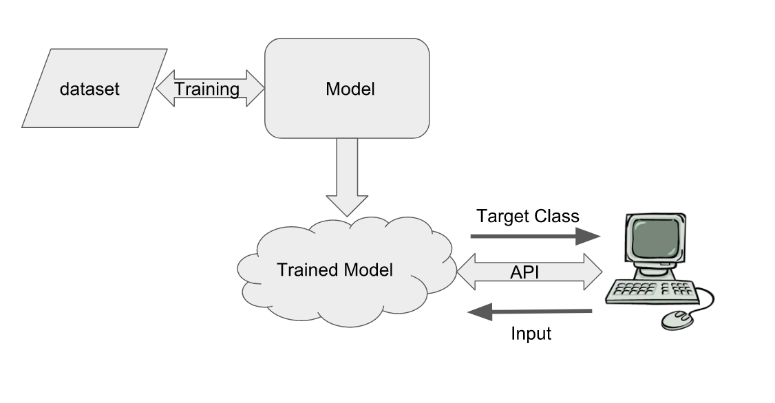
How it works in production

Slide 7
Example Dataset: Malware Classifier
56 features extracted from PE files using pefile
2 classes
138047 samples
https://github.com/Te-k/malware-classification

Slide 8
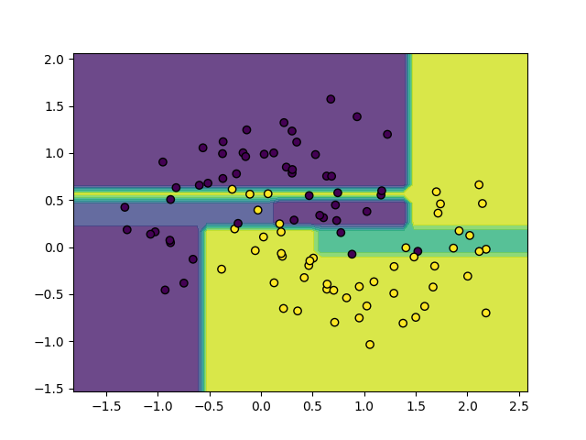
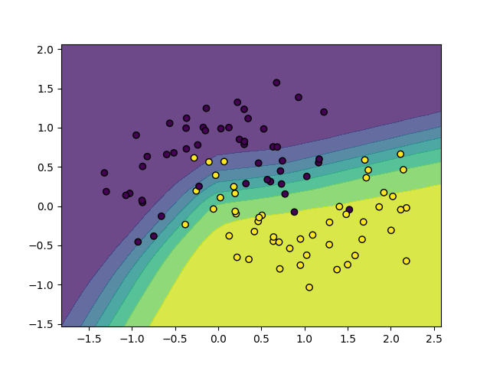
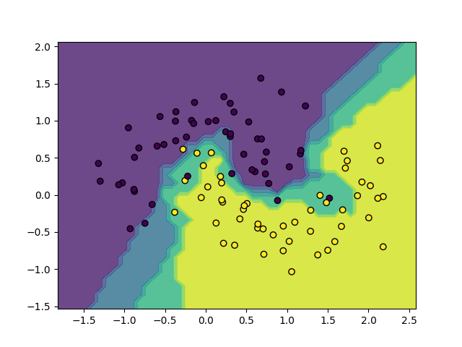
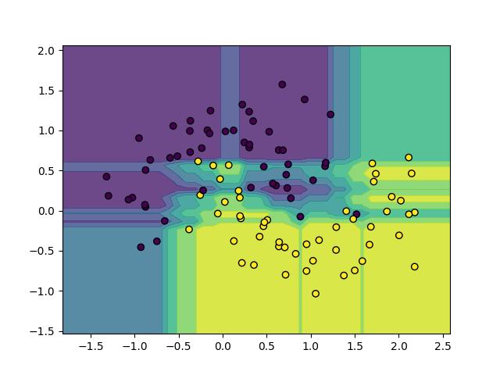
How a Trained Model Works?

Slide 9
Machine Learning: Logistic Regression

Slide 10
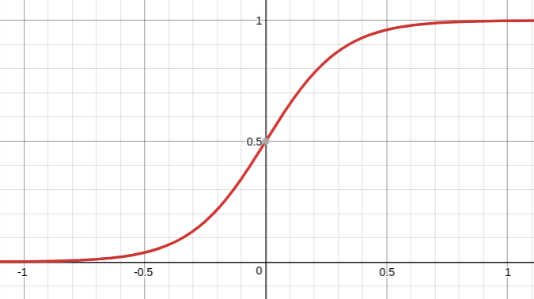
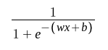
Logistic Regression

Slide 11
More ML Algorithms
Linear Regression
Decision Tree
Random Forest
Support Vector Machines
...

Slide 12
Deep Learning

Slide 13
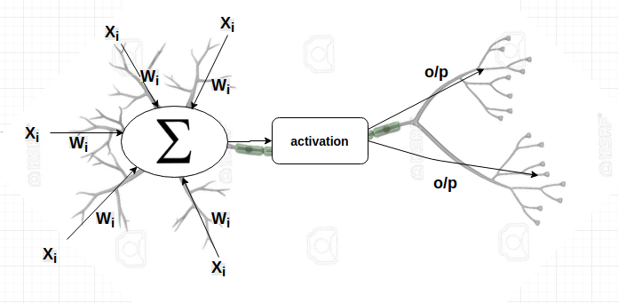
Neural Networks Building Block

Slide 14
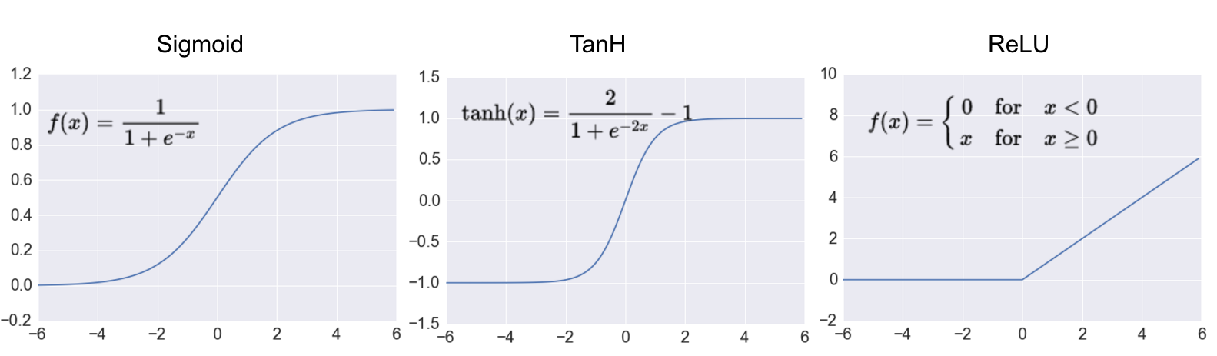
Activation functions

Slide 15
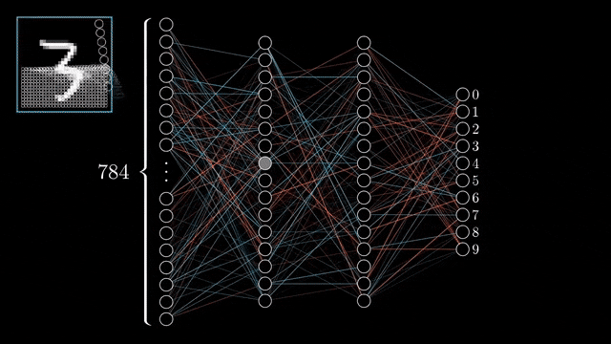
Initialization
Gif is taken from 3blue1brown’s video

Slide 16
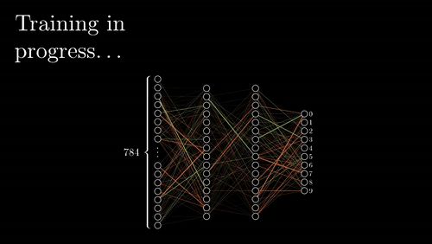
Training
Gif is taken from 3blue1brown’s video

Slide 17
Optimization Algorithms
Loss function
Input Parameters
Trained
Parameters
Optimizer
{W, b}
{W, b}

Slide 18
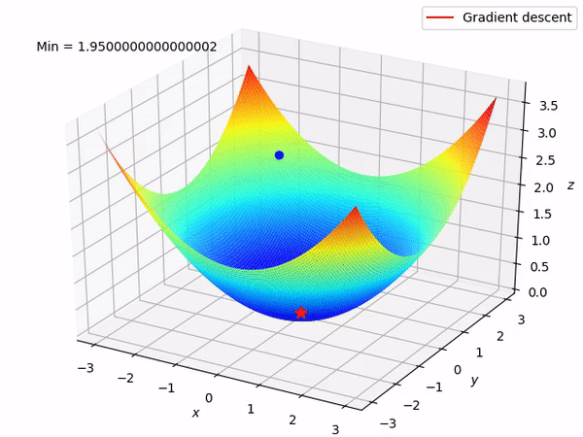
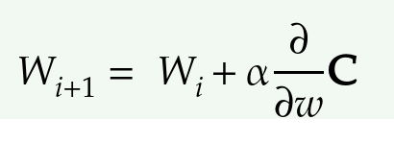
Convex Optimization Algorithms

Slide 19
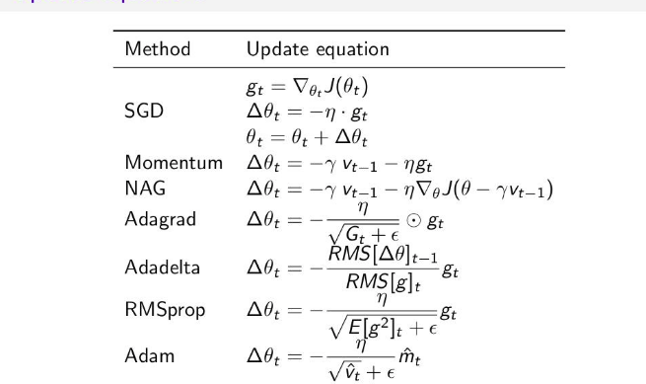
Convex Optimization Algorithms

Slide 20
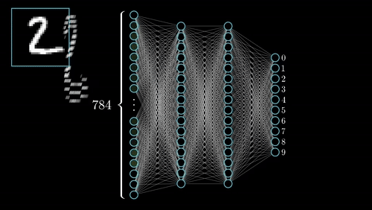
Prediction
Gif is taken from 3blue1brown’s video

Slide 21
More DL Algorithms
Convolutional Neural Networks
Recurrent Neural Networks
Long Short Term Memory Networks (LSTM)
Deep Belief Networks
Autoencoders
...

Slide 22
Malware Classifier

Slide 23
Dataset: Malware Classifier
56 features extracted from PE files using pefile
2 classes
138047 samples
https://github.com/Te-k/malware-classification

Slide 24
Building Model: Malware Classifier
Load Dataset
Pre process data
Split into training and testing set
Train Logistic regression model
Train Neural Network model
Evaluate trained models on testing set
Deploy the best model

Slide 25
Thank You!
@adversarial_nik

